Slide 1
Bearing Friction
Dr. Jacob Moore
Associate Professor of Engineering
Penn State Mont Alto

Slide 2
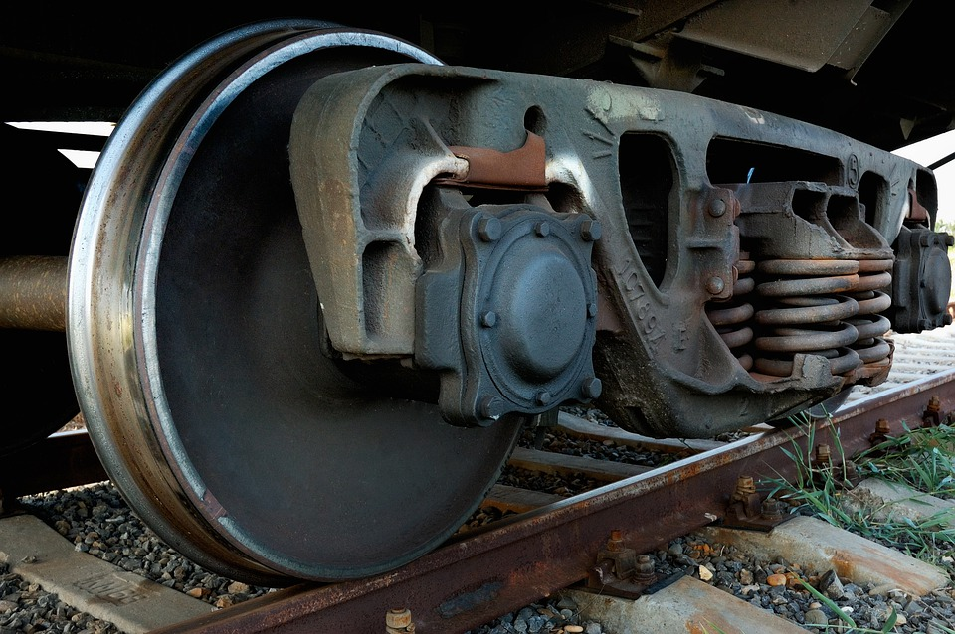
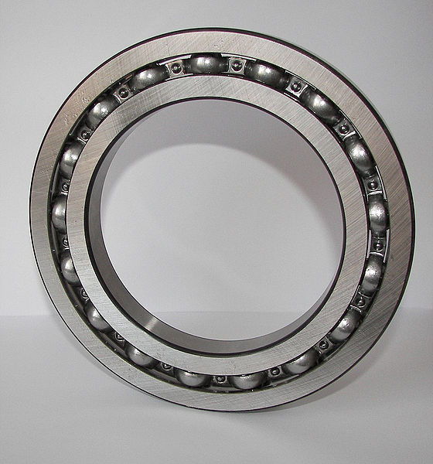
Bearings
A bearing is used to connect a rotating shaft to a stationary object.
Bearings are usually designed to minimize friction, but some friction will inevitably cause resistance to the rotation.
Public Domain Image by ds_30
Image by Solaris2006 CC-BY-SA 3.0

Slide 3
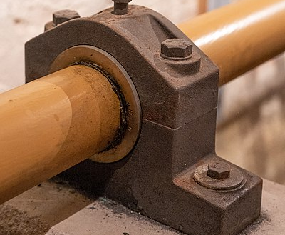
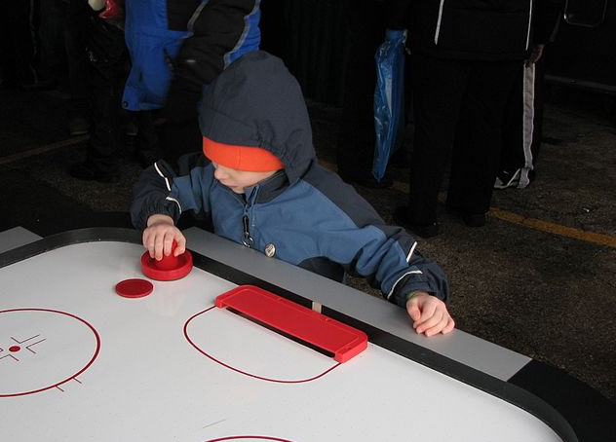
Types of Bearings
Journal (Plain) Bearing
Hydrodynamic Bearings
Ball Bearings
or
Roller Bearings
Image by Jay Clark CC-BY 2.0
Image by Tobias ToMar Maier CC-BY-SA 3.0
Image by Solaris2006 CC-BY-SA 3.0

Slide 4



Journal Bearings and Bearing Friction
$$F_{Load}$$
$$F_{f}$$
$$F_{N}$$

Slide 5


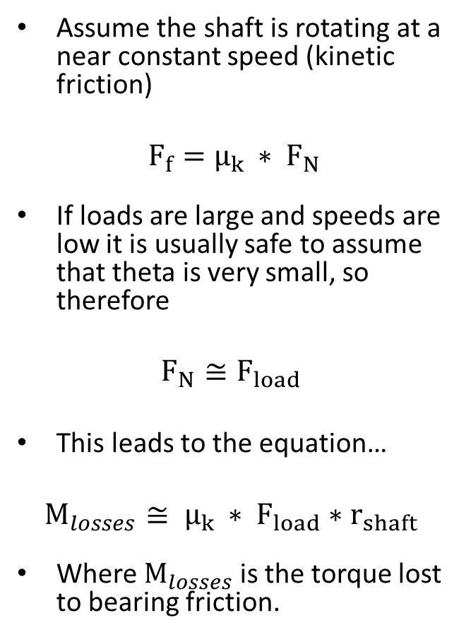


Journal Bearings and Bearing Friction
Assume the shaft is rotating at a near constant speed (kinetic friction)
$F_{f}=μ_{k }∗ F_{N}$
If loads are large and speeds are low it is usually safe to assume that theta is very small, so therefore
$$F_{N}≅F_{load}$$
This leads to the equation…
$$M_{losses}≅ μ_{k }∗ F_{load}∗r_{shaft}$$
Where $M_{losses}$ is the torque lost to bearing friction.
$$F_{Load}$$
$$M_{in}$$
$$F_{f}$$
$$F_{N}$$
Θ

Slide 6

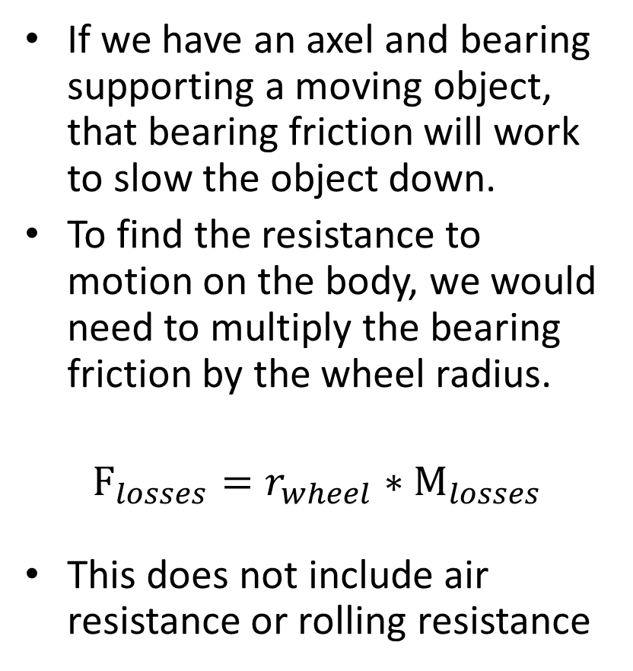
Bearing Friction and Wheels
If we have an axel and bearing supporting a moving object, that bearing friction will work to slow the object down.
To find the resistance to motion on the body, we would need to multiply the bearing friction by the wheel radius.
$$F_{losses}=r_{wheel}∗M_{losses}$$
This does not include air resistance or rolling resistance
Public Domain Image by ds_30

Slide 7
Thanks for Watching
See other engineering mechanics videos and access the full tool at…

Slide 8

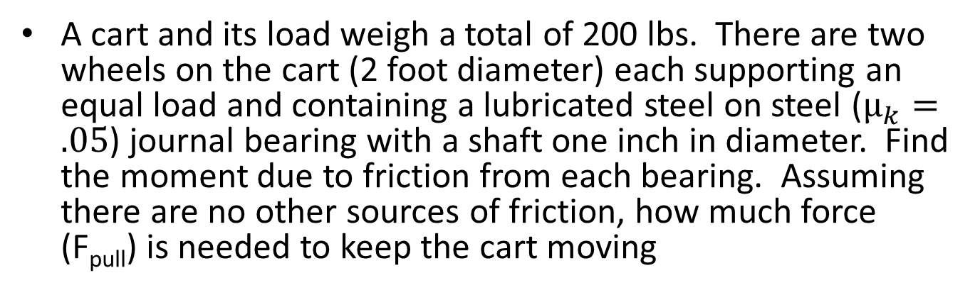
Bearing Friction Worked Example
A cart and its load weigh a total of 200 lbs. There are two wheels on the cart (2 foot diameter) each supporting an equal load and containing a lubricated steel on steel ($μ_{k}=.05$) journal bearing with a shaft one inch in diameter. Find the moment due to friction from each bearing. Assuming there are no other sources of friction, how much force (F_{pull}) is needed to keep the cart moving
$$F_{pull}$$

